Slide 1
Outdoor Environment and Play Experiences
ECERS-R
San Francisco Quality Connections

Slide 2
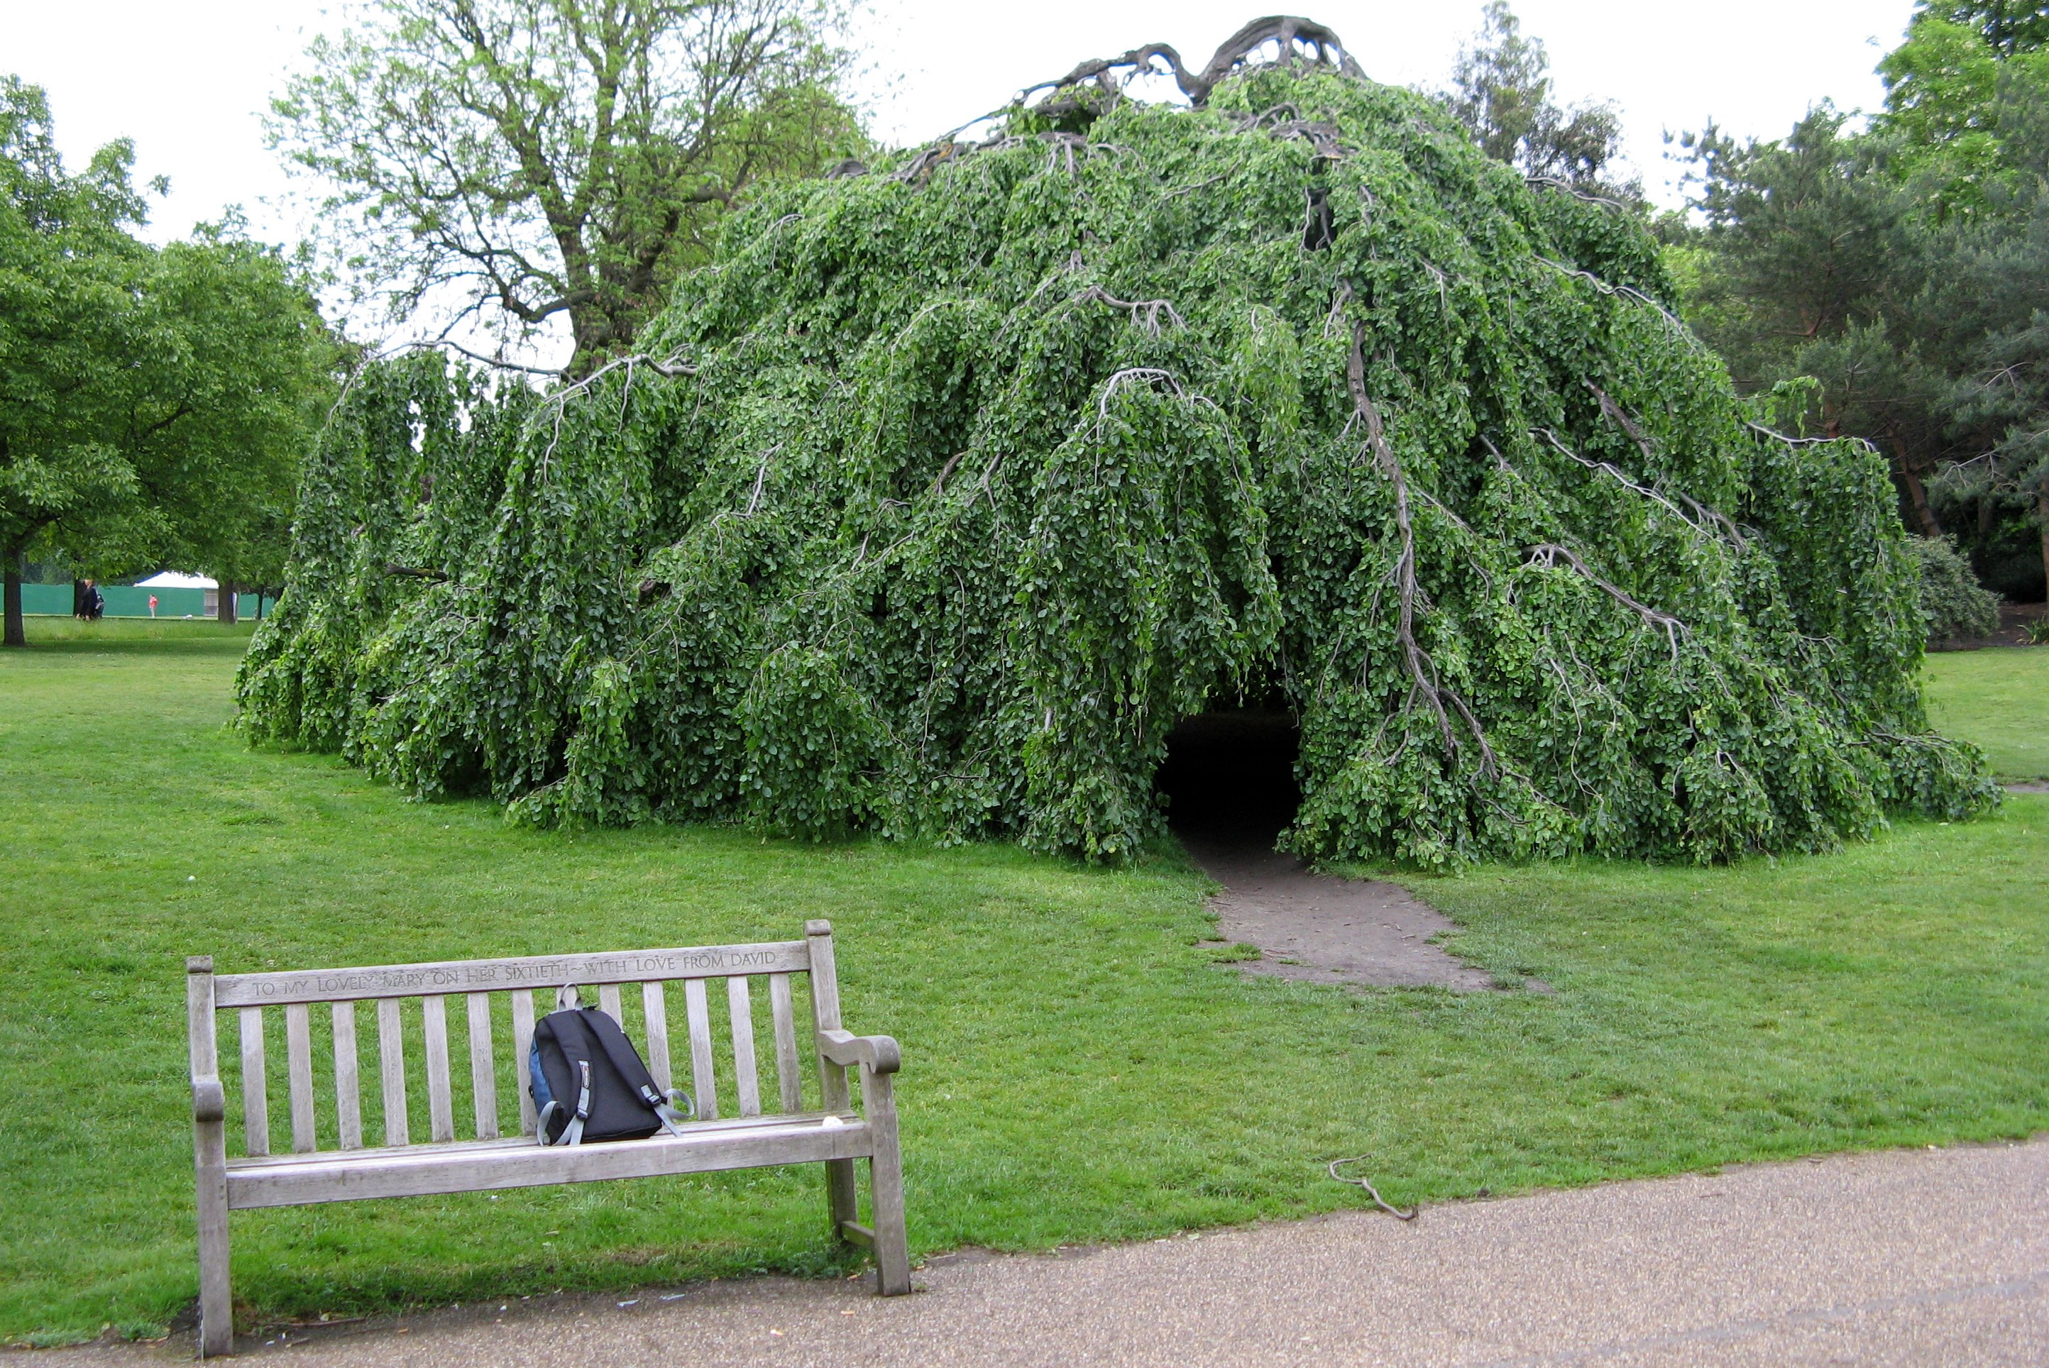
Open spaces to play

Slide 3
Overview
ECERS-R Items:
  7. Space for gross motor play
  8. Gross motor equipment
  29. Supervision of gross motor activities

Slide 4
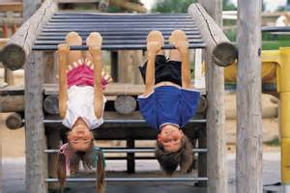
Children should have
Time to play outdoors every day
Interactions that support children’s gross motor development
Space to engage in gross motor play

Slide 5
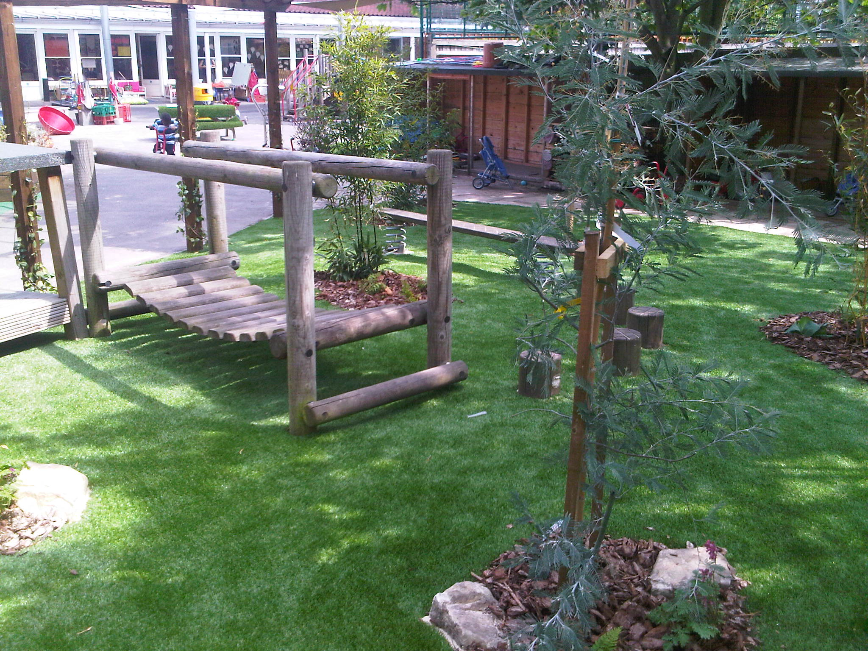
Time
At least one hour a day for programs serving children for 8 hours or more
Time for gross motor play during any type of weather outdoors or indoors

Slide 6
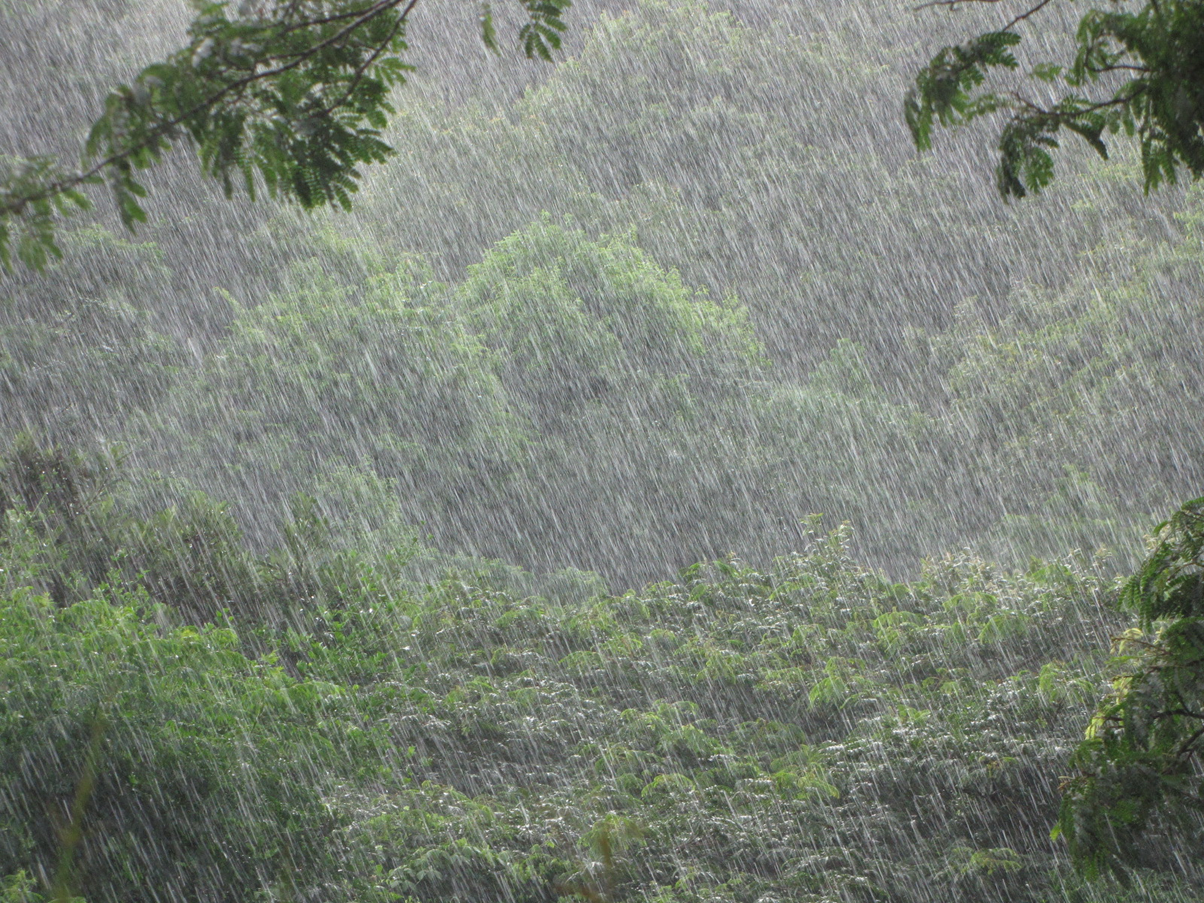
Weather permitting???
Children can’t use outdoor play space due to:
-Public health department recommendation (air quality, etc…)
-Don’t have a covered space where children can play or proper clothing for the weather to play outside

Slide 7
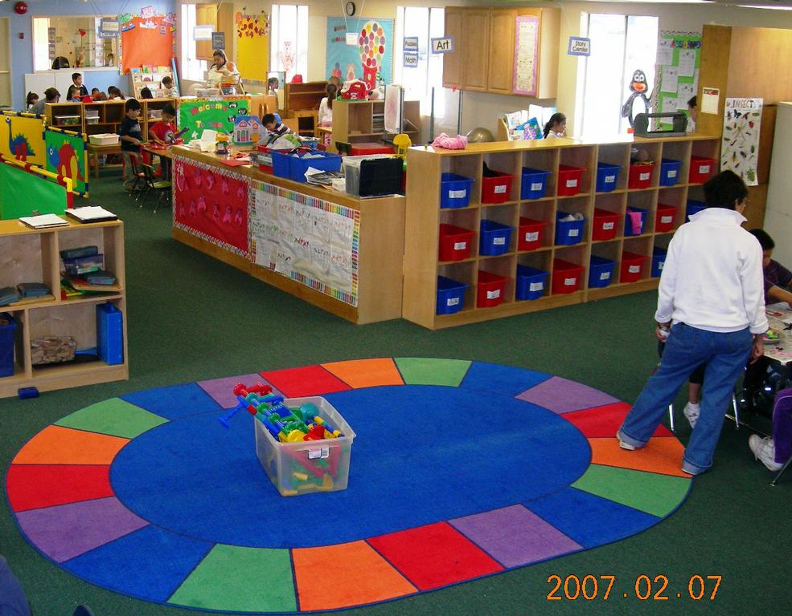
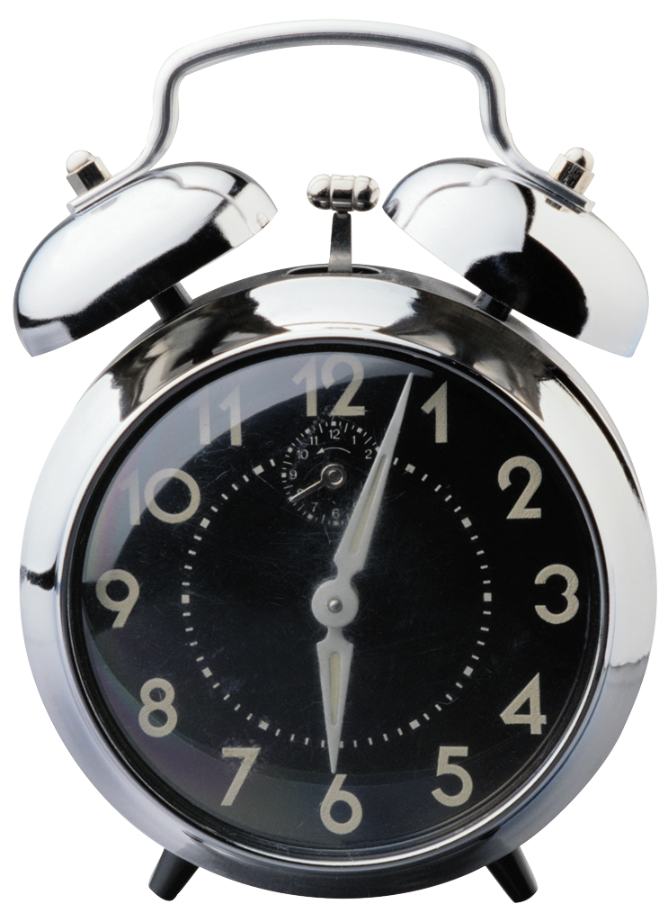
No outdoor play area?
Indoor space that safely allows children to engage in gross motor play.
Use the indoor space for the same amount of time.

Slide 8
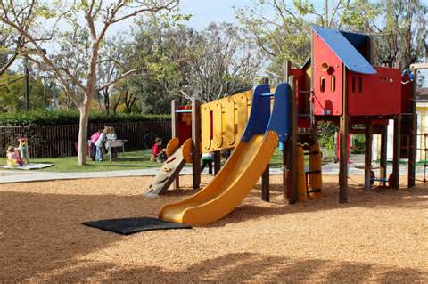
Space used for gross motor play should…
Offer children opportunities to develop many gross motor skills
Be used daily
Be age-appropriate and safe

Slide 9

Observe for safety hazards
Fall zones around climbing equipment
Entrapment
Protruding nails or pieces of equipment
Uneven surfaces that may cause children to trip
Height and spacing of equipment
Sufficient cushioning on climbing equipment

Slide 10

Organization of the play space
Observe to see what children are doing in the gross motor space
  Are children using the equipment available to them? Are they engaging in “Big Body Play”?
  Where are children engaging in play?

Slide 11
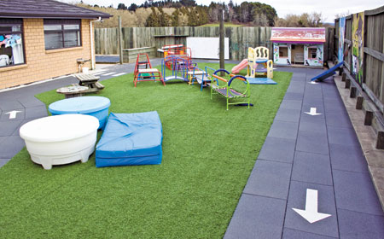
Organization of play space
Managing playground traffic patterns
-Wheeled equipment
-Climbing equipment
-Ball play
-Sand play
-Active symbolic play

Slide 12
Offer children experiences that develop 7 or more gross motor skills
Equipment
Skill
Climber
Balls of various sizes
Jump rope
Hula hoops
Wheeled toys
Climbing and sliding
Kicking, throwing, catching, tossing
Jumping and skipping
Full body hula
Pedaling, pushing, pulling

Slide 13
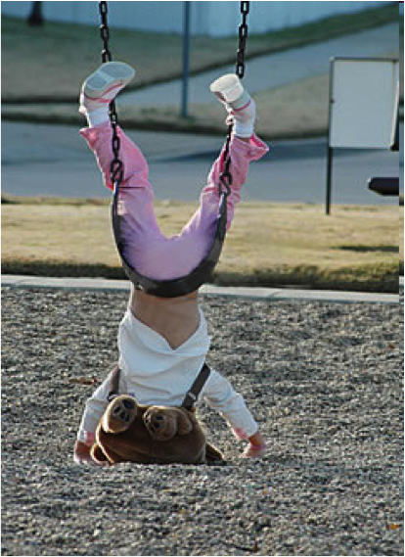
Interact with children engaged in gross motor play
In addition to keeping children safe, staff should support children’s concept development, positive social interaction with each other, and offer assistance when children are practicing a new gross motor skill.

Slide 14
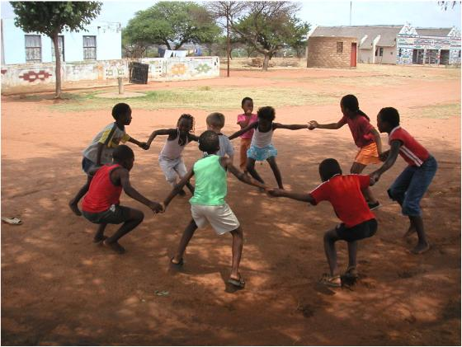
Supervising gross motor play
Staff observe and engage with children in their play.
Based on their observation, staff add new equipment or arrange equipment differently to enhance children’s play.
When engaging with children staff introduce concepts related to children’s gross motor play.

Slide 15
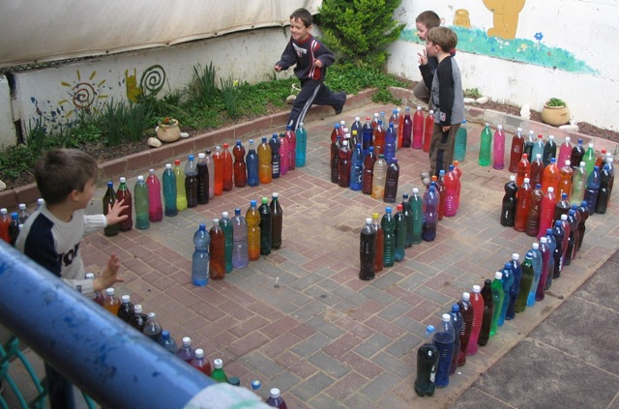
Support active play!

Slide 16
References
Carlson, F. M., (2011). Big Body Play, Why Boisterous, Vigorous, and Very Physical Play is Essential to Children’s Development and Learning. National Association for the Education of Young Children
Cryer, D., Harms, T., & Riley, C. (2003). All about the ECERS-R, Hong Kong: Pact House Publishing.
Harms, T., Clifford, R. M., & Cryer, D. (2005). Early Childhood Environment Rating Scale – Revised Edition. New York and London: Teachers College Press.
Additional Notes For Clarification for the ECERS-R: http://www.ersi.info/
U.S. Consumer Product Safety Commission. (n.d.). Handbook for Public Playground Safety, http://www.cpsc.gov/cpscpub/pubs/325.pdf

